Slide 1
MATH1023/MATH1024
2018-C Semester

Slide 2
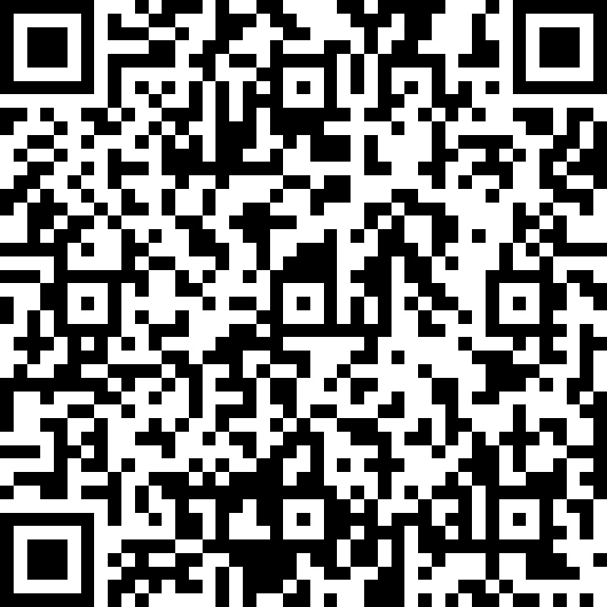
3 September 2018, Week 2
Open this form:
https://goo.gl/egRJvX

Slide 3
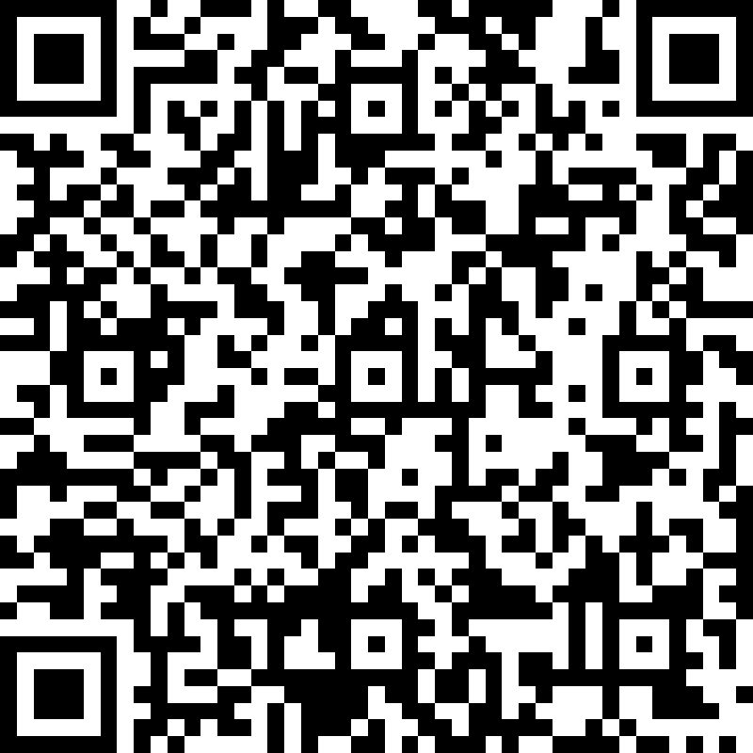
26 September 2018
https://goo.gl/47T635

Slide 4
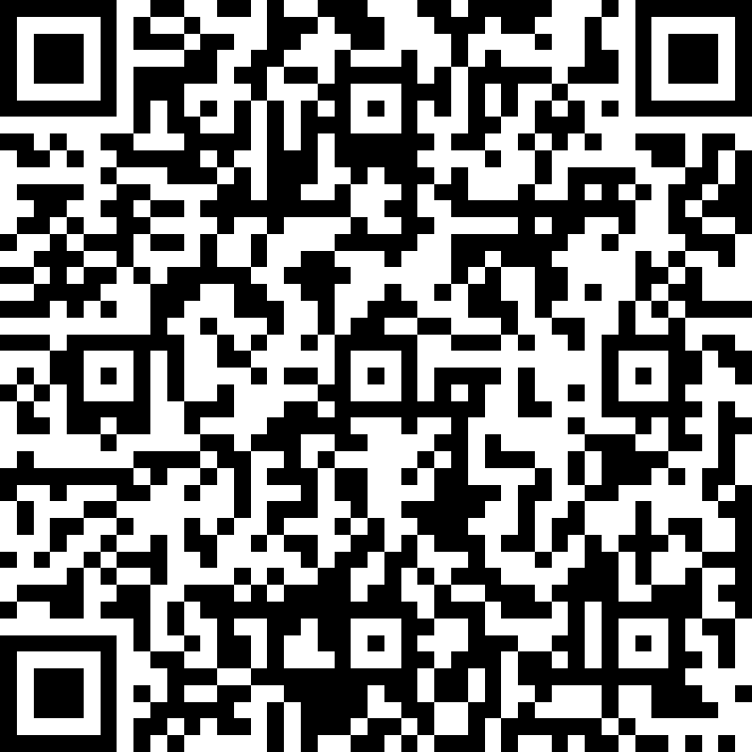
1 Oct 2018
https://goo.gl/trRQwB

Slide 5
Tutorial Groups Registration Forms
Group 1: Wednesday 8 am to 9 am
https://goo.gl/forms/EjIzVzG25Kc2QpTh2
Group 2: Tuesday 12 pm to 1 pm
https://goo.gl/forms/zzGd64OC1F6fVhpW2
Group 3: Wednesday 4 pm to 5 pm
https://goo.gl/forms/9YhjManvmvQaViyh1

Slide 6
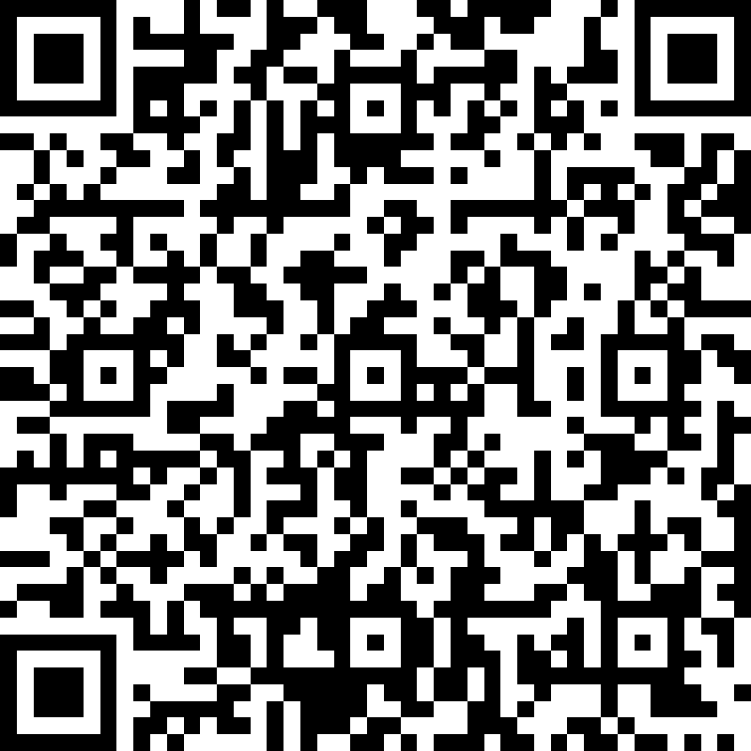
8 Oct 2018
https://goo.gl/tpLz43

Slide 7
Test 1
22 October 2018, 9 am to 11 am

Slide 8
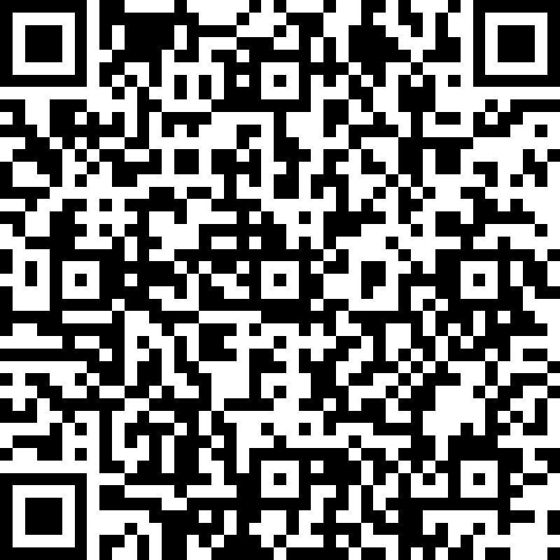
29 Oct 2018
https://goo.gl/Aj6AzB

Slide 9
29 Oct 2018
Why are you
not attending tutorials?

Slide 10
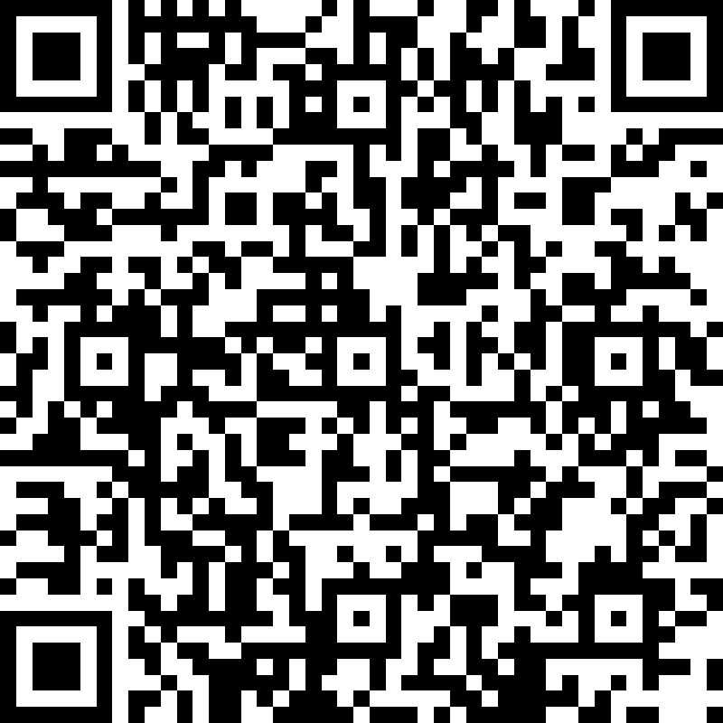
5 Nov 2018
https://goo.gl/SpsS3H

Slide 11
Replacement Class
7 November 2018, Wednesday
5 pm to 7 pm
Venue: IEB 416

Slide 12
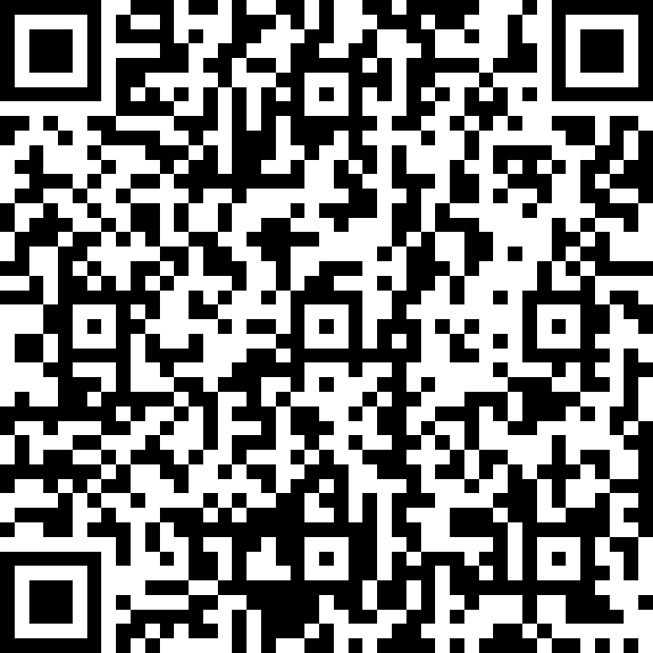
7 Nov 2018
https://goo.gl/Go3QZQ

Slide 13
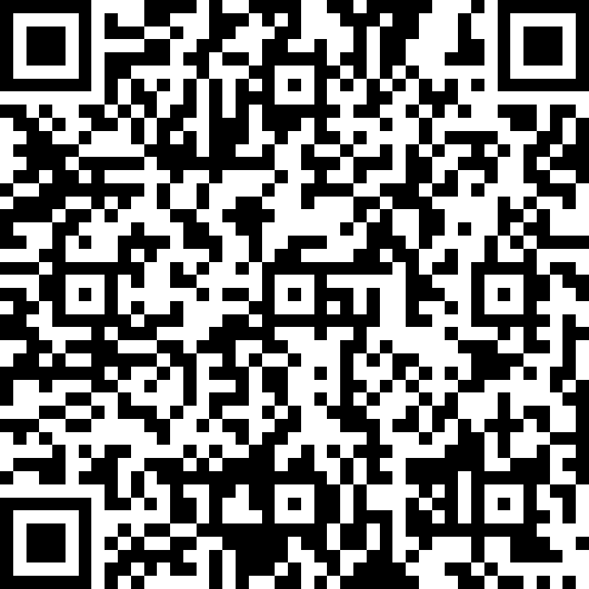
12 Nov 2018
https://goo.gl/wBiQKu

Slide 14
Replacement Class
14 November 2018, Wednesday
5 pm to 7 pm
Venue: IEB 416

Slide 15
Test 2
26 November 2018, Monday
9 am to 11 am
Venue: IEB 416

